Slide 1

Disk Manager A Solution for File Management
Team : INT_WIN
Aditya Aggarwal
Girish Gupta
Manav Sidana
​​

Slide 2
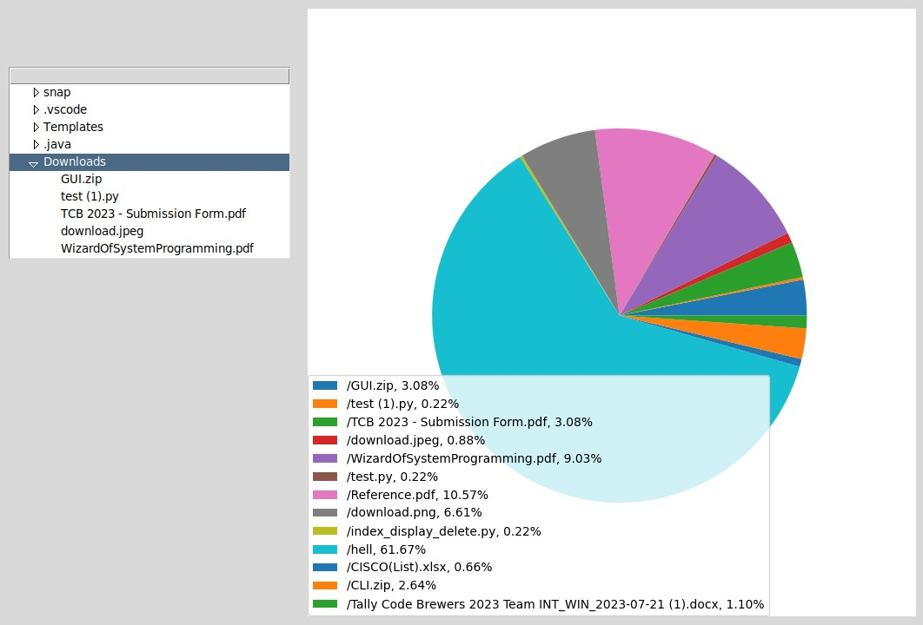
Key features :
Search for Duplicate Files
Delete Temporary Files
Show Largest Files in Directory
Check for Duplicate and Similar Text or Image Files
Schedule and Delete Temporary Files
GUI for enhanced user interaction
Disk Space Viewer

Slide 3
Solutions:
Duplicate Files
Delete Temporary Files
Scan selected directories for identical files.
Detect similar text or image files using advanced algorithms.
Choose to delete or retain duplicates and similar files.
Detect temporary files and caches.
Manually select files to delete or schedule clean-ups.
Largest Files
GUI/CLI
List largest files in a directory.
Sort and filter files by size or date.
Make informed decisions on file retention.
Enhanced user experience
Both options are provided for usage

Slide 4
Advanced Features and Ram Usage
Advanced features
Ram Usage:
Scheduling and Deleting Temporary Files.
Using NLP (Preprocessing) for duplicate file detection
Providing user insights on disk and space usage using GUI.

Slide 5
Thank you

